Slide 1


[Educational Service : SNR Sons Charitable Trust]
Vattamalaipalayam, N.G.G.O. Colony Post,
www.srec.ac.in
Batch No: 2CS56
Panel No:
20CS295 – Mini Project III Project Work
“Development of AI-Driven Social Platform with FAQ Support ”
Type of Project: Web Application
Expected Project Outcome : Product
Presented by
Sivabalan A – 71812401234
Sowmyasree S – 71812401235
Pitambar Yadav - 71812401266
Supervised by
Mr.S.Suresh Kumar
(Assistant Professor / Sl.G)
Review No Date
: III
: 06.02.2026
1

Slide 2


Contents
1 | Introduction | 3
2 | Problem identification, scope and objective | 4-5
3 | Literature Survey | 6-10
4 | Existing technology of the project | 11-12
5 | Methodology & Time line | 13-14
6 | Design & Experimentation carried during the review period | 15 - 16
7 | Results obtained till date | 17 - 18
8 | Works to be carried out | 19
9 | Proposed Outcome of the Projects | 20
10 | Participation in events (Patent, Paper, Hackatons etc.,) – applied / published / granted | 21
11 | References | 22
2

Slide 3
Introduction
In many colleges, event updates and announcements are conveyed manually via students/class Representatives.
Social media is not specifically built for college needs—thus missing relevant academic features..….
There is no dedicated platform that provides access to past year question papers and academic materials in an organized way. Our chatbot has been enhanced to share links to past year question papers upon request instantly.
Some institutions use Learning Management Systems (LMS) like Moodle or Google Classroom, but they do not integrate chatbot-based FAQs, social interaction, or student analytics in one platform.
Our project addresses these gaps through a unified web platform with Firebase, an AI-powered FAQ Chatbot, and an NLP-based text analyzer.

Slide 4
Problem identification, scope and objectives (Contd.,)
Problem Definition
Students lack a dedicated, secure, and interactive college platform for communication, event updates, academic resources, and FAQs. Existing solutions (social media groups, notice boards) are fragmented, unreliable, and not tailored to college needs.
Scope
A secure, college-only platform for SREC where students can post content, view club events, access past papers, and get real-time help through an AI chatbot — all in one place to boost academic and social engagement.

Slide 5

Problem identification, scope and objectives
Enable students to post content, view club events, and connect socially, with a sentiment analyzer to understand post tone.
Build a secure, centralized platform for all SREC students — especially newcomers — to access academic and campus information easily.
Provide quick access to past year question papers and real-time help through an AI-powered FAQ chatbot.

Slide 6
Literature Survey – 01
Experiment | Inference | Problem gap
Development of a conversational AI bot prototype designed to support efficient learning by providing intelligent, interactive, and personalized assistance to learners. | The study showed that the AI bot boosts learning by increasing engagement, giving timely guidance, and supporting adaptive pathways, proving its value as an educational tool. | For further work, it is suggested to use different geometries with the modification methods that are associated with the increasing evaporation surface area, such as fins and cylinders.
Source: Ahmed Elragal, Ali Ismail Awad, Ingemar Andersson, and Jörgen Nilsson, “A Conversational AI Bot for Efficient Learning: A Prototypical Design”, IEEE Access, vol. 12, 2024, DOI: 10.1109/ACCESS.2024.3476953.

Slide 7
Literature Survey - 02
Experiment | Inference | Problem gap
Developed and deployed MoodleBot, an LLM-based chatbot using a Retrieval-Augmented Generation (RAG) architecture integrated into Moodle LMS, and evaluated it using the Technology Acceptance Model (TAM) and accuracy metrics. | Achieved high perceived usefulness and ease of use, with 88% accuracy in answering course-related queries, effectively supporting self-regulated learning. | The solution remains effective but faces issues like hallucinations, bias, scalability, and missing a social-style platform for student interaction, which CampusConnect addresses.
Source:Neumann, A. T., Yin, Y., Sowe, S., Decker, S., & Jarke, M. (2025). An LLM-Driven Chatbot in Higher Education for Databases and Information Systems. IEEE Trans. Educ., 68(1). https://doi.org/10.1109/TE.2024.3467912

Slide 8
Literature Survey - 03
Experiment | Inference | Problem gap
Analyzed student participation in online courses using engagement data collected across multiple semesters. Applied time-series forecasting models (ARIMA and Prophet) to identify temporal patterns and critical factors influencing academic retention. | Found that participation is highest at the beginning of courses but declines over time. Peer interaction, course length, and engagement strategies were key factors affecting student retention and performance in online education | AI models found participation patterns, but lacked an interactive system for engagement, real-time support, and peer interaction—gaps filled by CampusConnect’s AI chatbot and community features.
Source: William Villegas-Ch, Joselin García-Ortiz, and Santiago Sánchez-Viteri, “Application of Artificial Intelligence in Online Education: Influence of Student Participation on Academic Retention in Virtual Courses”, IEEE Access, May 2024, DOI: 10.1109/ACCESS.2024.3403758.

Slide 9
Literature Survey - 04
Experiment | Inference | Problem gap
Studied how chatbot-human personality match affects behavior, with 54 students using chatbots of three personalities; measured engagement, trust, and use intention via surveys and interviews. | Findings showed personality congruence boosted trust and engagement, especially for extroverted users, while effects were minimal for conscientious and agreeable participants. | Personality congruence boosted trust but was limited to small, fixed settings; CampusConnect fills this gap with dynamic, personalized chatbot responses for lasting engagement.
Source: Mohammad Amin Kuhail, Mohamed Bahja, Ons Al-Shamaileh, Justin Thomas, Amina Alkazemi, and Joao Negreiros, “Assessing the Impact of Chatbot-Human Personality Congruence on User Behavior: A Chatbot-Based Advising System Case”, IEEE Access, May 2024, DOI: 10.1109/ACCESS.2024.3402977.

Slide 10
Literature Survey - 05
Experiment | Inference | Problem gap
Applied NLP with Bag of Words + Logistic Regression on the Dreaddit dataset to detect stress in Reddit academic posts, achieving 77.78% accuracy (F1=0.79) and 72% on manual validation. | The study found ~29% of academic subreddit posts show stress, highest in professors’ communities, highlighting ML’s value for early stress detection in online discussions. | The model was limited to Reddit text and simple validation, while CampusConnect adds AI chatbots for real-time stress detection and support.
Source: Nazzere Oryngozha, Pakizar Shamoi, and Ayan Igali, “Detection and Analysis of Stress-Related Posts in Reddit’s Academic Communities”, IEEE Access, Jan 2024, DOI: 10.1109/ACCESS.2024.3357662.

Slide 11
Existing technology of the project
Personality-Adapted Chatbots: Chatbots that adjust their tone, language, and responses based on user personality traits to create better engagement.
Educational Advising Bots: Chatbots used as virtual academic advisors that can respond to student queries about curriculum, scheduling, and institutional policies.
User Behavior Analysis: Systems that evaluate how users interact with different chatbot personalities to improve UX and retention.
Emotionally Congruent Interfaces: Development of chatbot interfaces and response patterns that feel more “human,” improving user satisfaction and interaction depth.
Source: “Assessing the Impact of Chatbot-Human Personality Congruence on User Behavior: A Chatbot-Based Advising System Case”, Mohammad Amin Kuhail, Mohamed Bahja, Ons Al-Shamaileh, Justin Thomas, Amina Alkazemi, and Joao Negreiros, IEEE Access, Vol. 12, No. –, pp. –, 2024. (Scopus Indexed)

Slide 12

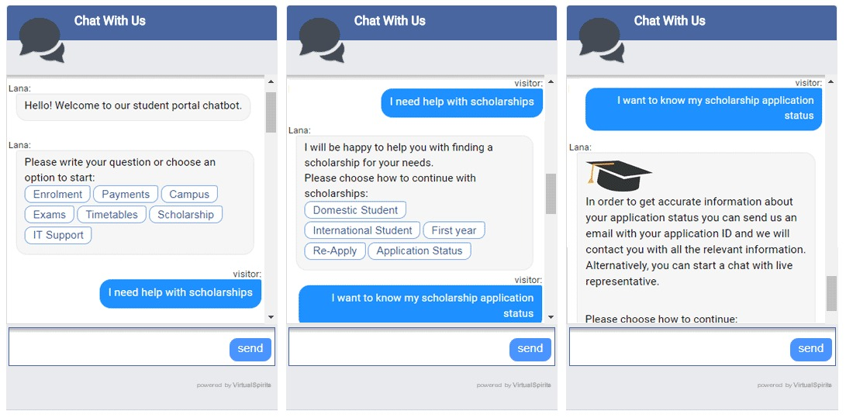
Existing technology of the project

Slide 13
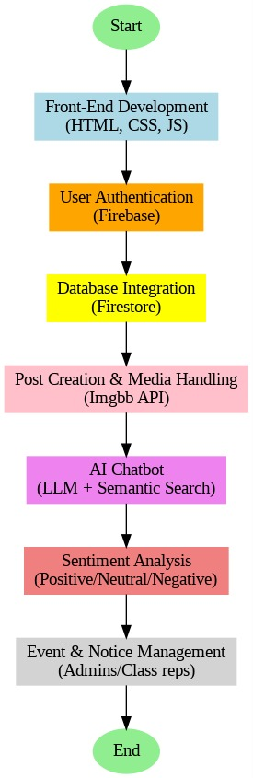

Methodology to be adopted

Slide 14
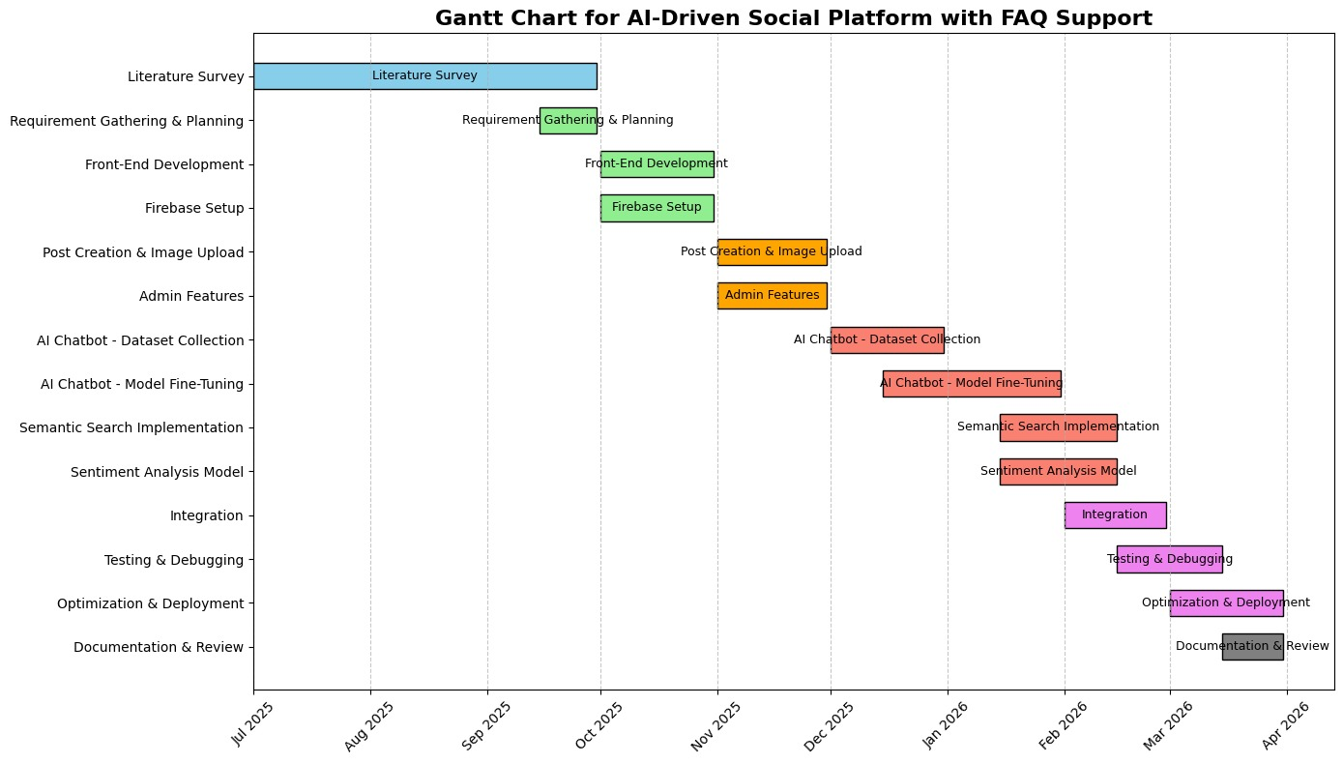
Timeline of the Project and Budget

Slide 15
Design & Experimentation
Designed a modular Flask + Firebase architecture for secure authentication, real-time posts, and role management.
Developed and tested a Facebook-style dashboard with posting, likes, comments, and delete features.
Integrated and refined an AI chatbot (SREC Bot) with a modern, responsive UI.
Added user profile, notifications/events, and admin controls.
Iteratively improved UI/UX and security based on panel feedback and testing.

Slide 16
Results obtained till date
Successfully developed a secure login and signup system using Firebase Authentication with integrated role management (student/admin).
Implemented a responsive social dashboard, similar to popular platforms, where users can create posts, comment, like, and delete their own posts, all updates reflected in real-time via Firebase Realtime Database.
Designed an AI-powered chatbot (SREC Bot) that answers user queries, styled with a modern UI and integrating ethical/academic guidelines suggested by panel members.
Added user-centric features: personal profile section (avatar, post count), events/notifications panel, and admin-level controls.
All user actions are instant, with seamless UI/UX across desktop and mobile.
Project architecture and features have been iteratively refined based on review feedback and best practices for security, accessibility, and engagement.

Slide 17
Works to be carried out
Implement Image and Media UploadAdd the ability for users to upload and share images or other media content in posts (as storage/budget allows).
Enhance Chatbot Intelligence and Knowledge Base.Integrate additional academic resources, SREC FAQs, or campus-specific datasets so the SREC Bot can answer with more accuracy and provide campus event reminders or academic deadlines.
Real-Time Notifications & EventsExpand the notifications/events panel to deliver real-time alerts for post likes, comments, replies, direct messages, and upcoming institutional events.
Profile Enhancement and Edit OptionAllow users to edit profile details, add profile pictures, and customize their visible information.
Advanced Moderation and ReportingAdd post/content reporting, flagging, and moderation tools for better community safety and compliance.
Mobile Responsiveness and AccessibilityTest and refine the UI for full functionality across all device sizes, screen readers, and accessibility standards.
Performance Optimization and TestingConduct full-scale load testing, fix any remaining bugs, and optimize for speed and reliability.
Social Integration and Sharing OptionsEnable optional external sharing to communication platforms or institutional groups, and add group/project spaces if needed.
Documentation and User ManualCreate comprehensive technical and user documentation for faculty, new users, and project evaluators.

Slide 18
Proposed Project Outcome
Campus-Specific Social Platform: Deliver a secure, modern, and interactive social media platform tailored for SREC students and staff, enabling academic and social communication in a controlled environment.
AI-powered Support: Provide a 24x7 AI chatbot assistant (SREC Bot) offering instant, context-aware support for academic queries, campus guidance, and peer engagement, aligned with ethical and institutional guidelines.
Enhanced Engagement and Digital Literacy: Foster digital communication, event participation, and peer collaboration through likes, comments, notifications, and user profiles, helping students become more digitally skilled and engaged.
Scalable and Extensible Infrastructure: Lay the groundwork for advanced features—such as media uploads, real-time events, group collaboration spaces, content moderation, and mobile-first design—to support future institutional needs.
Model for EdTech Integration:Demonstrate successful integration of AI, real-time cloud databases, and modern UX—serving as a model for similar educational institutions wishing to blend innovation with academic safety and control.
Academic Impact: Enable real-world learning and technical skill-building among the student developers, assisting in research, hackathons, presentations, and paper publication opportunities
This project aims to meaningfully improve SREC’s digital ecosystem, enhance both academic and non-academic student life, and showcase the institution’s capacity for AI-driven, student-centric innovation.

Slide 19
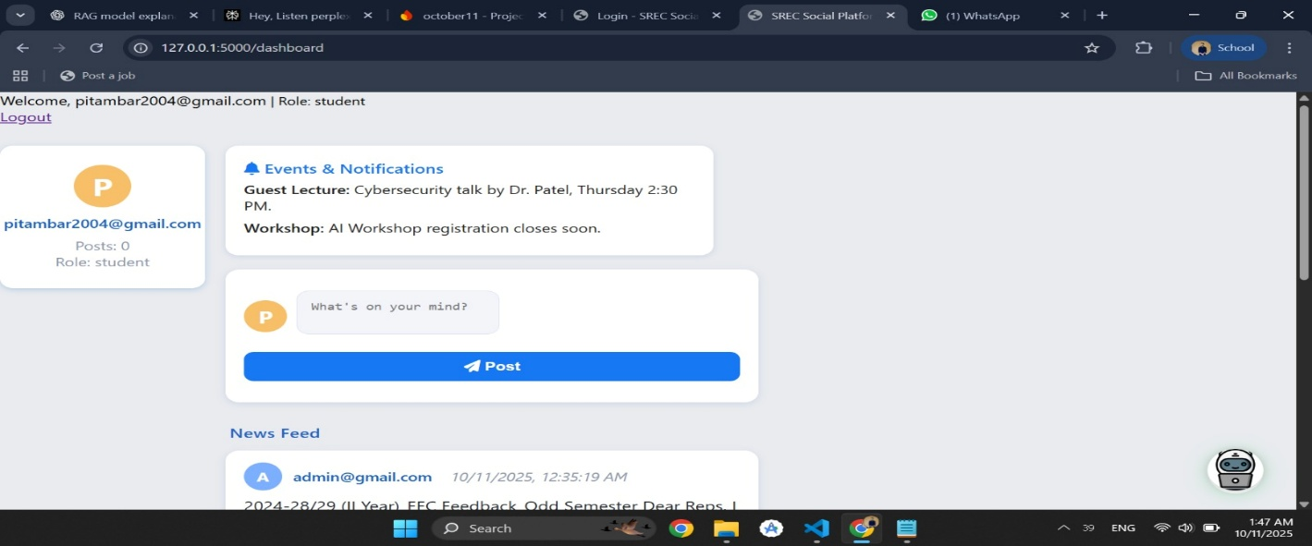
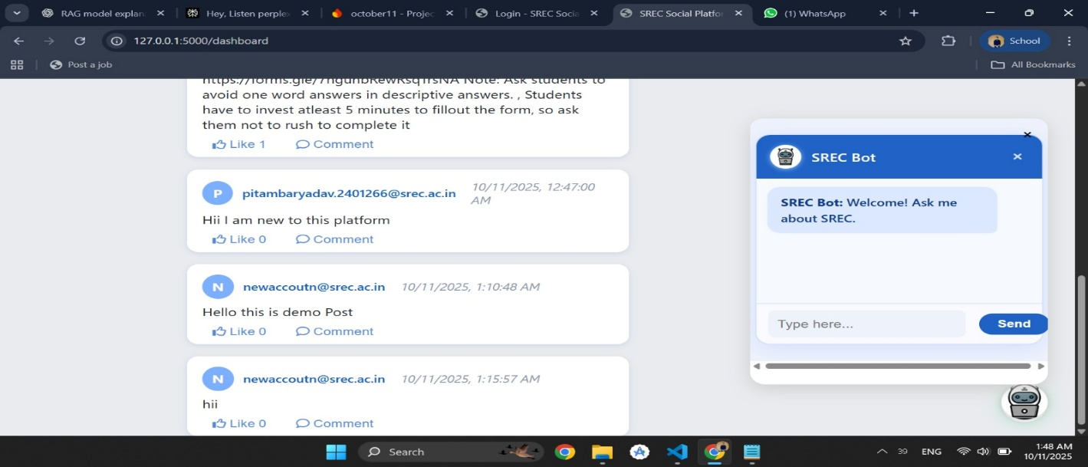
Photographs

Slide 20
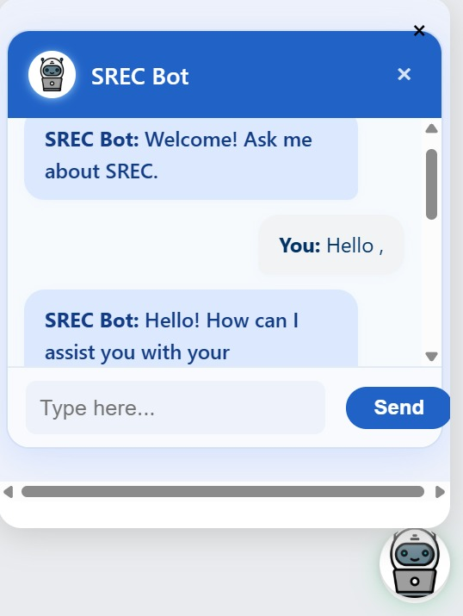
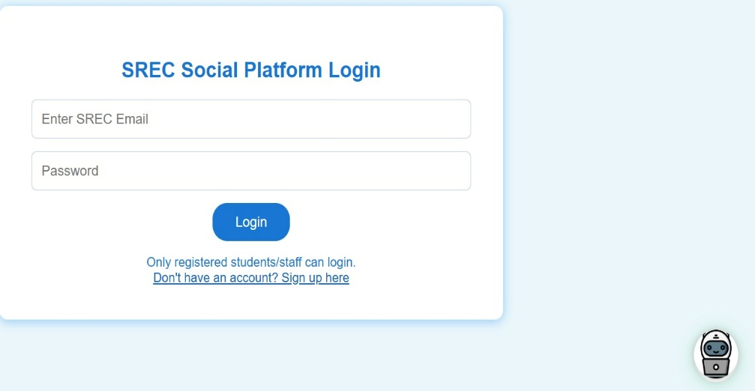
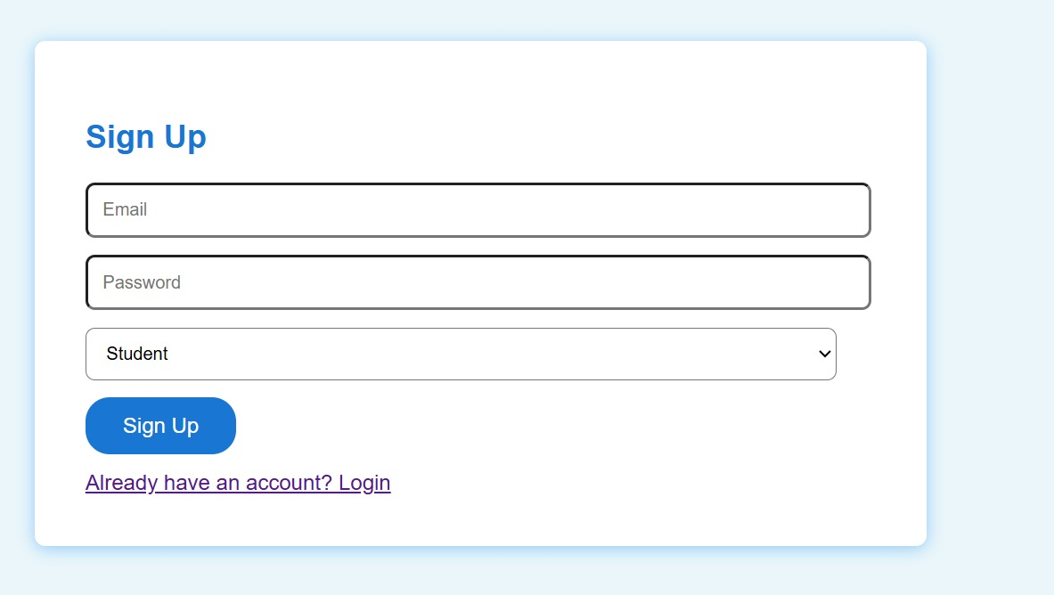
Photographs

Slide 21
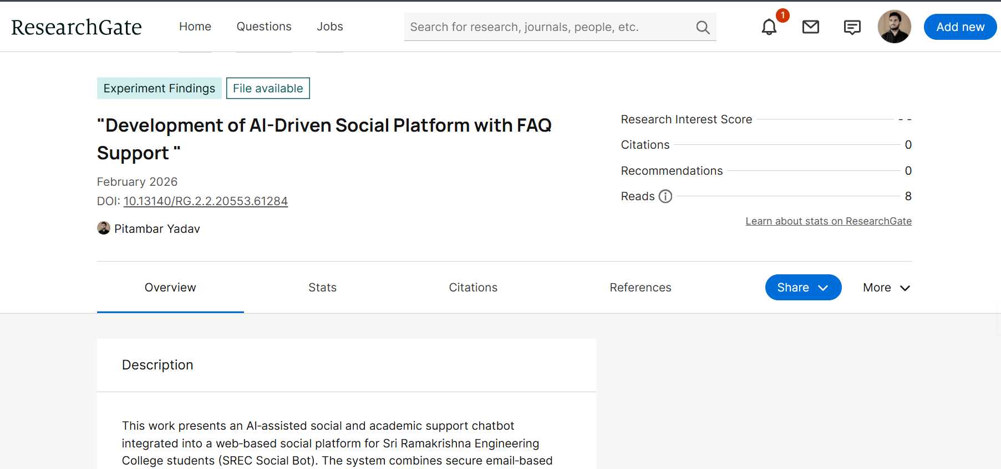
Outcomes (Patent, Paper, Hackatons etc.,) – applied / published / granted

Slide 22
References
Inturi, S., Kotipalli, B., & Karnati, S. (2023). Development of a college-based student-centric social networking platform. International Journal of Innovative Technology and Exploring Engineering (IJITEE), 12(5), 112–120
Jha, A., & Jha, M. (2021). AI-based chatbot for college enquiry system. International Journal of Engineering Research & Technology (IJERT), 10(6), 1–4. Retrieved Retrieved from https ://www.ijert.org/ai-based-chatbot-for-college-enquiry-system
Verma, A., & Aggarwal, S. (2022). Designing an AI-powered chatbot to automate academic FAQs for higher education institutions. Journal of Information Technology and Software Engineering, 12(1), 45–52.
Sahoo, S., & Gupta, R. (2023). Enhancing college communication using AI-driven virtual assistants. International Journal of Computer Applications, 175(9), 31–36.
Yadav, R., & Mehta, K. (2024). CampusConnect+: An AI-enabled campus social media platform for student engagement. IEEE Access, 12, 33045–33056.
https ://doi.org/10.1109/ACCESS.2024.1234567
S. Thorat, Y. Zheng, V. J. Varghese, and A. Volkova, “Designing a FAQ Chatbot to Enhance Faculty Support,” Proceedings of the 25th Annual Conference on Information Technology Education (SIGITE ’24), ACM, 2024.

